Slide 1
Tableau

Slide 2
Setup

Slide 3
Download Tableau public
Download the software:
https://www.tableau.com/products/desktop/download
Sample data:
https://learning-platform-danger.s3.ap-east-1.amazonaws.com/BI+Visualization/conduct.csv
https://learning-platform-danger.s3.ap-east-1.amazonaws.com/BI+Visualization/exam.csv
https://learning-platform-danger.s3.ap-east-1.amazonaws.com/BI+Visualization/student.csv
https://learning-platform-danger.s3.ap-east-1.amazonaws.com/BI+Visualization/demerit.csv

Slide 4
Basic usage

Slide 5
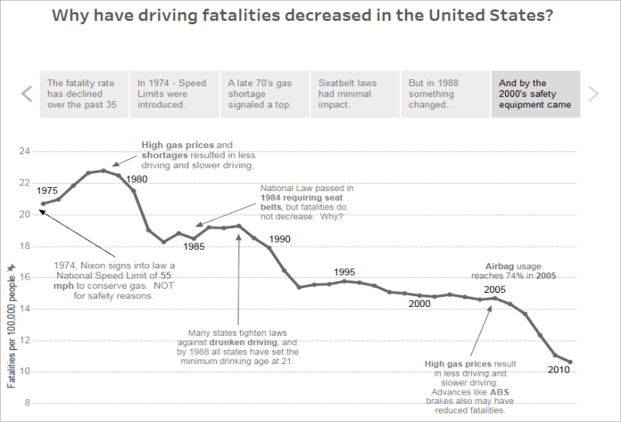
Key objects
Book
Data source
Sheet
Dashboard
Story
A story is a sequence of visualizations

Slide 6
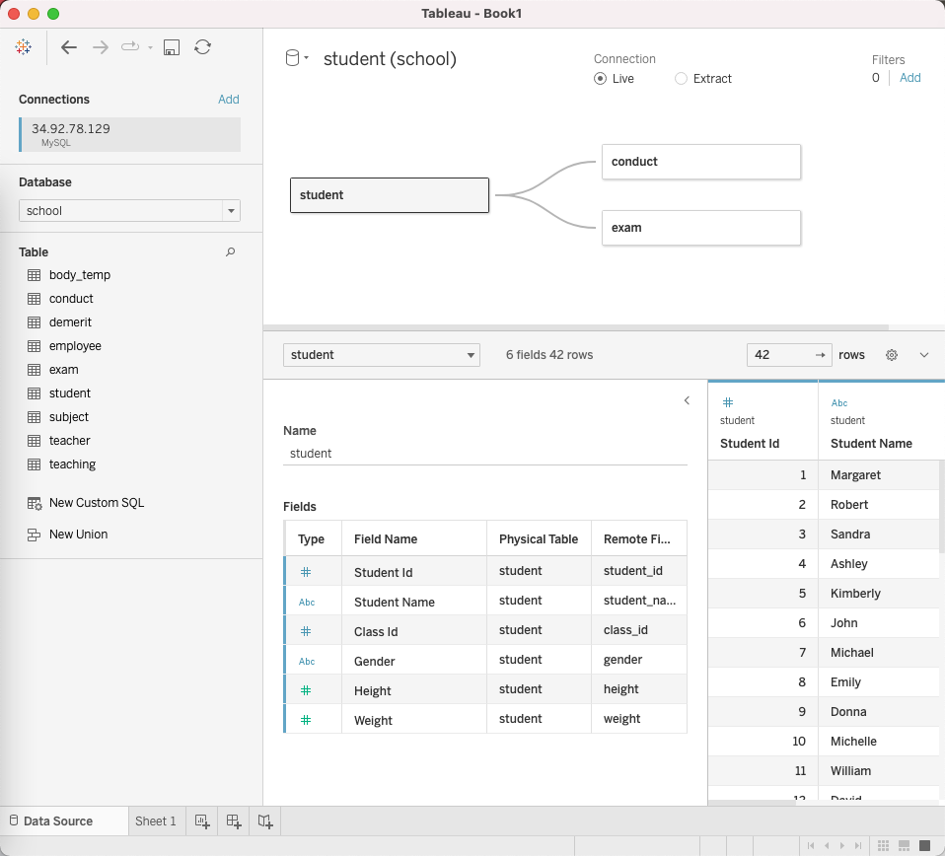
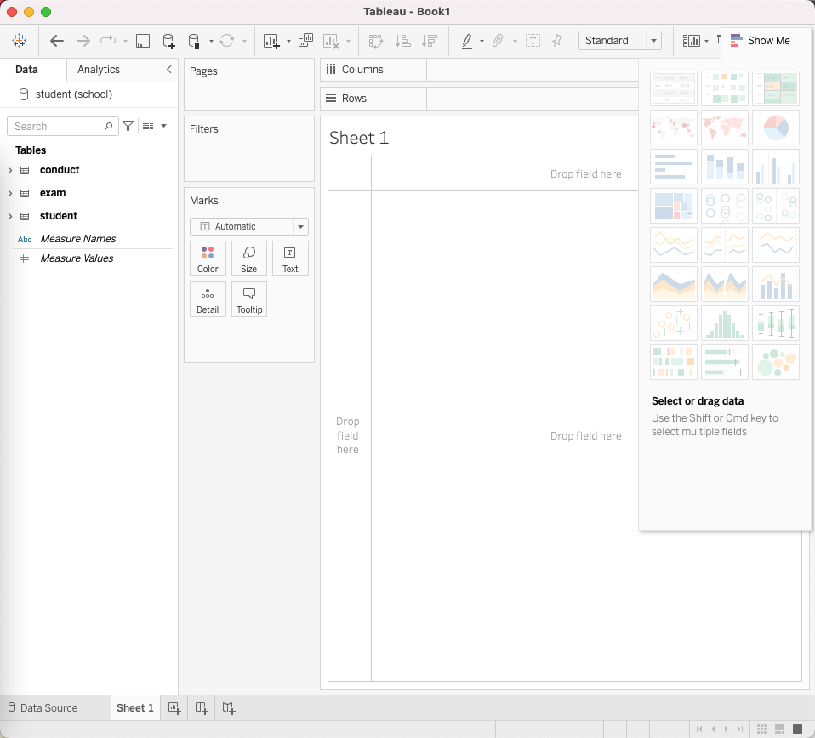
Workspace
The whole thing is a “book”, which can be saved in a file
Manage data sources
Work on worksheets

Slide 7
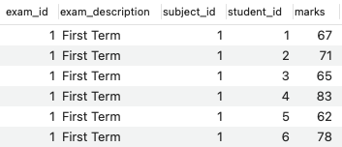
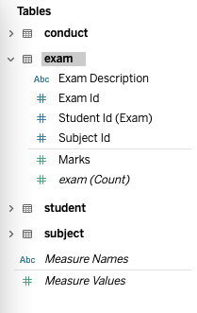
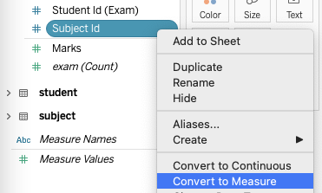
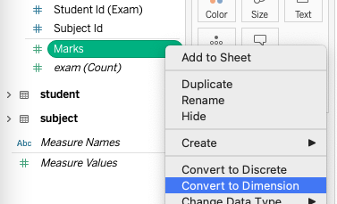
Dimension vs Measure
Tableau automatically detect if columns are dimension or measure, you can change the setting of the detection is wrong.
Upper part
Lower part

Slide 8
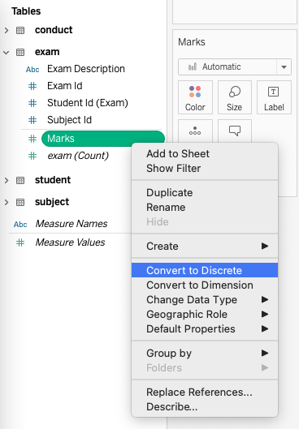
Discrete or continuous
Examples of discrete variables:
Group numbers
Categorical variables
Examples of continuous variables:
Height/Weight
Percentage

Slide 9
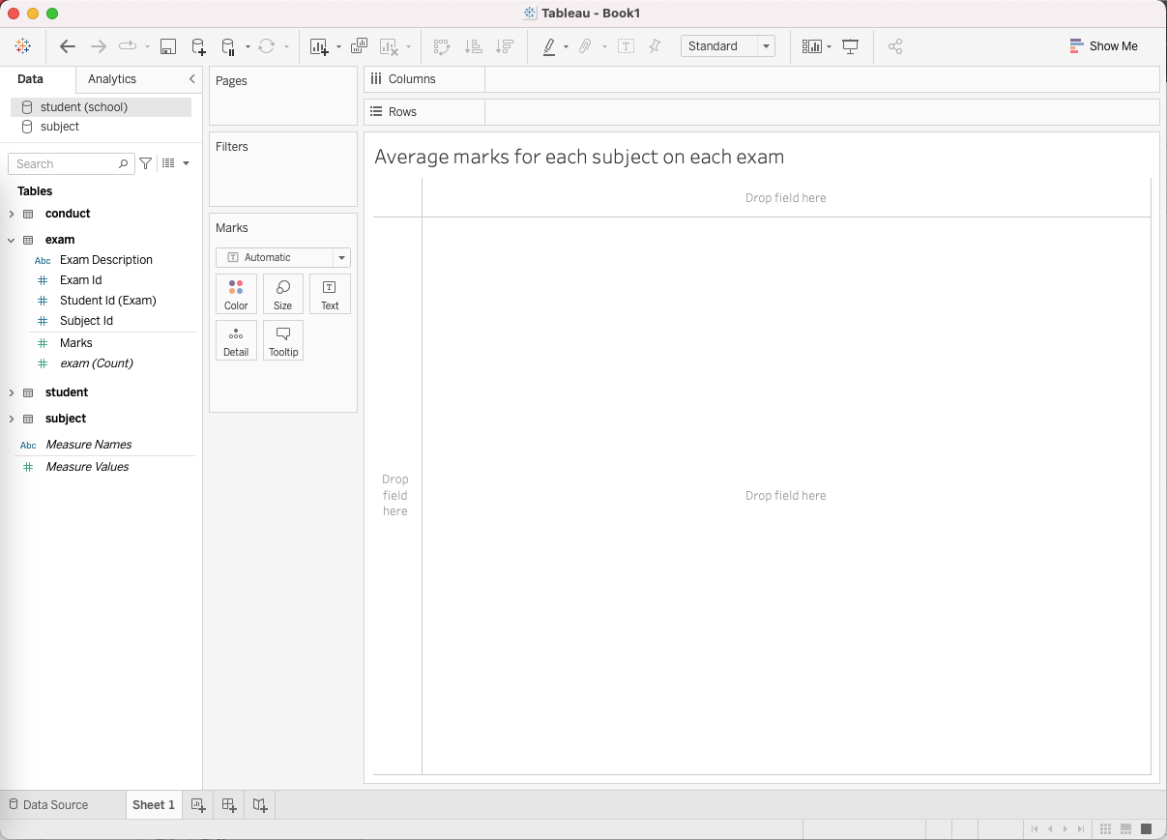
How to plot?
Drag dimensions or measures to columns or rows
Configure the graph elements

Slide 10
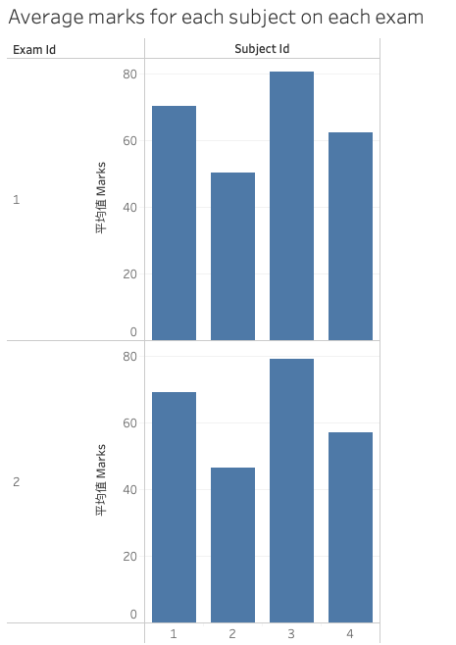
Exercise
Plot this graph ->

Slide 11
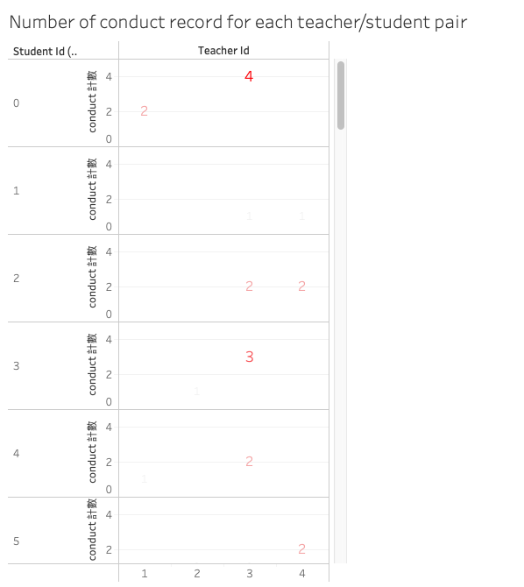
Exercise
Plot this graph ->

Slide 12
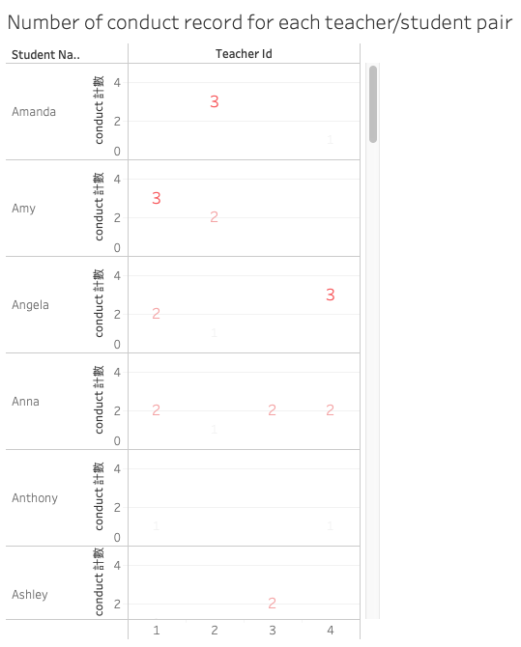
Exercise
How about we give each student their name?

Slide 13
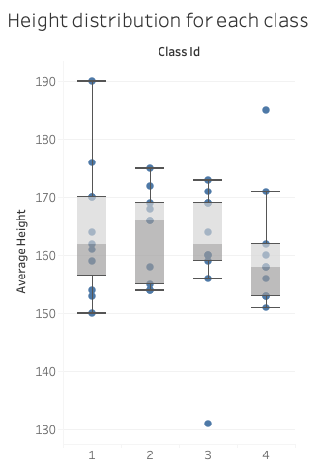
Exercise
Plot a box diagram to indicate the height distribution of each class

Slide 14
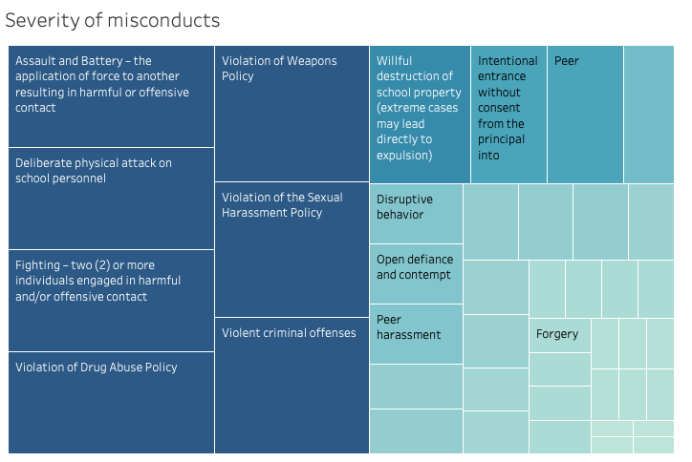
Exercise
To show the severity of each kind of misconduct.

Slide 15
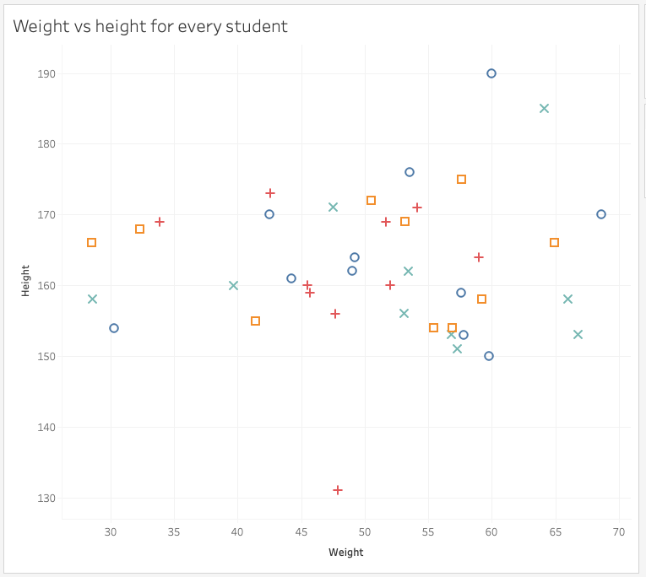
Exercise
How about scatter plot? Different marker for different class.

Slide 16
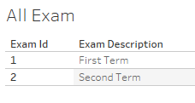
Exercise
How about a simple text table?

Slide 17
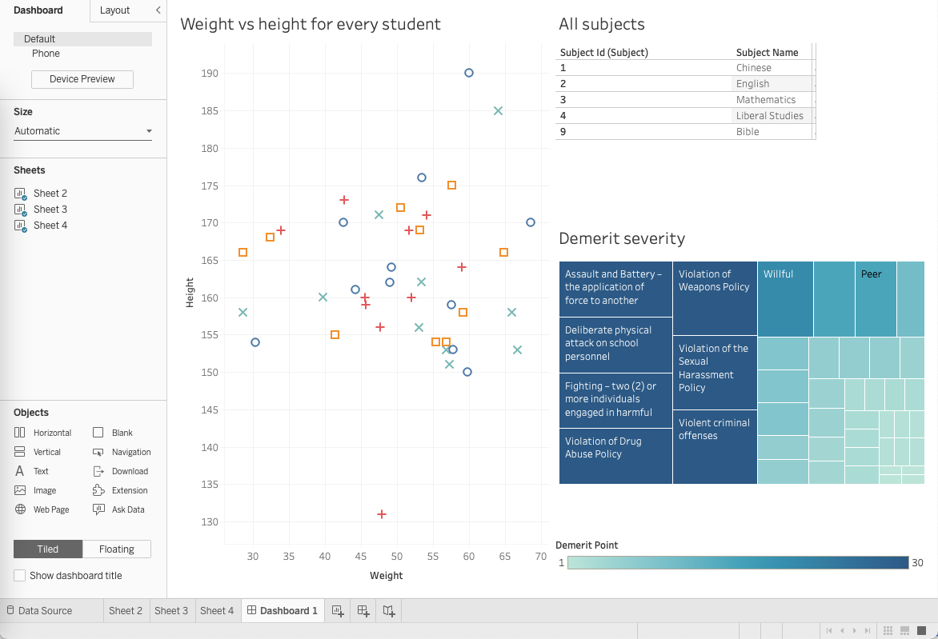
Dashboard
A dashboard group worksheets into one page.

Slide 18
Share your work

Slide 19
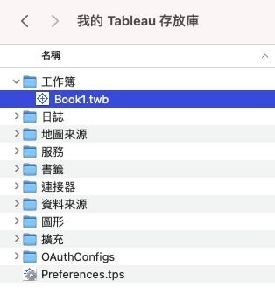
Share the book file
The workbook file is a self contained file.
It can be opened by other people in other computers.

Slide 20
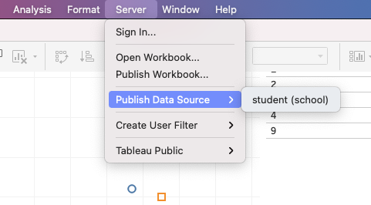
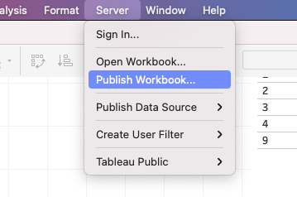
Share online
Tableau comes with an online service - Tableau online (not free).
Steps:
Publish data source
Publish workbook

Slide 21
Advanced usage

Slide 22
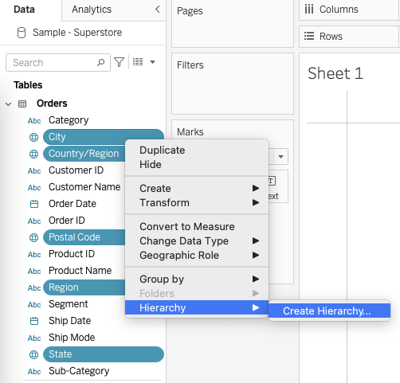
Hierarchy
We can group fields into a hierarchy for better management.

Slide 23
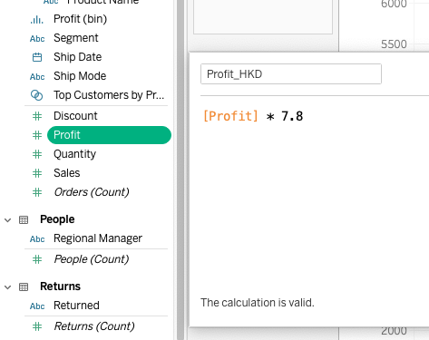
Calculated Field
We can create new field with a formula. The formula can contain one or more existing field denoted by [fieldname].

Slide 24
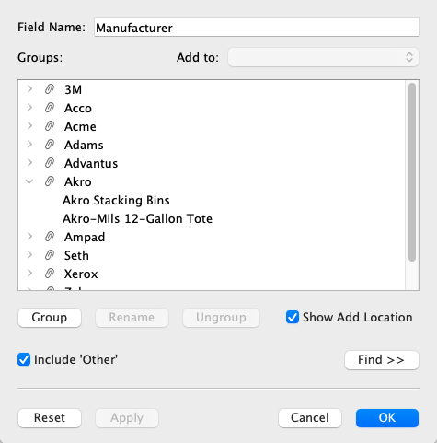
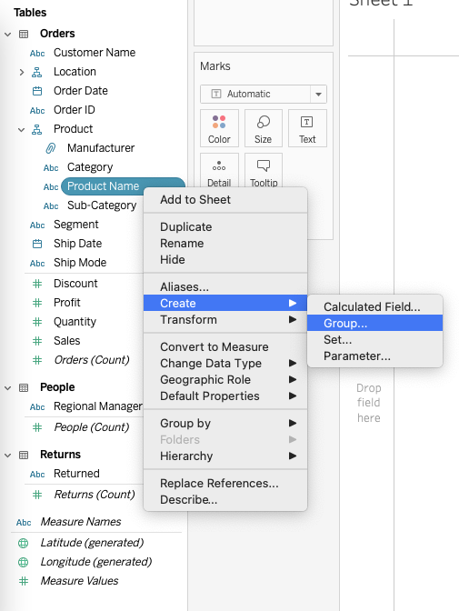
Group
Very similar to Calculated Field, but instead of creating new values with a function, “Group” creates a mapping between original value to a “Group”.
E.g. “Akro Stacking Bins” -> “Akro”

Slide 25
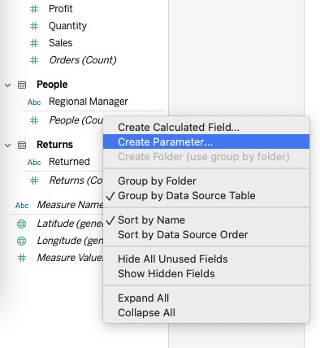
Parameters
Like “Variables”.
It is a variable that can be used in calculation and thus affect the graph layout.

Slide 26
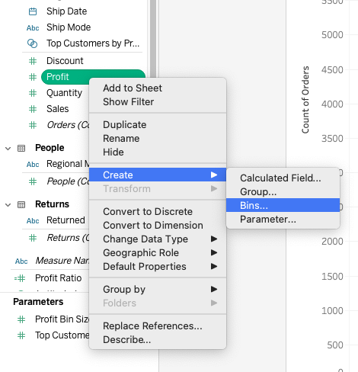
Bins
Another kind of calculated field. It turns a column of continuous values into discrete “bins”.
The biggest use case is to create histograms.

Slide 27
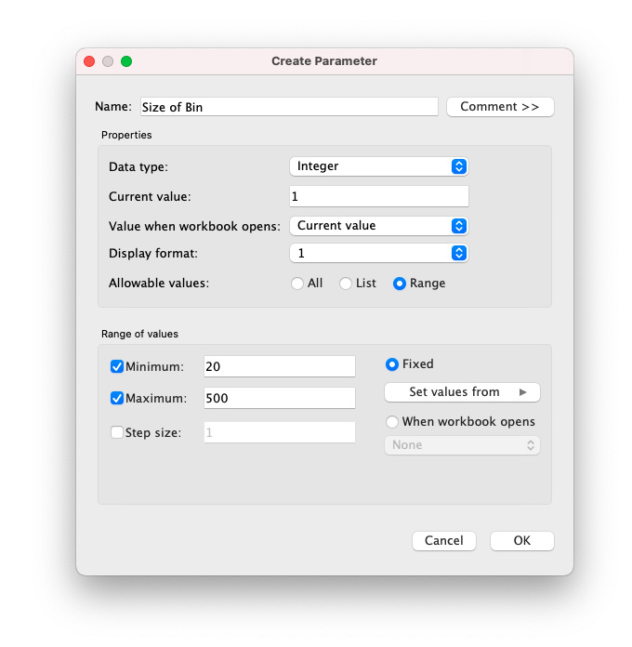
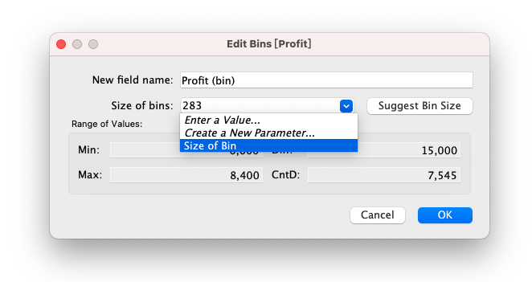
Example: Using parameter in Bins setting

Slide 28
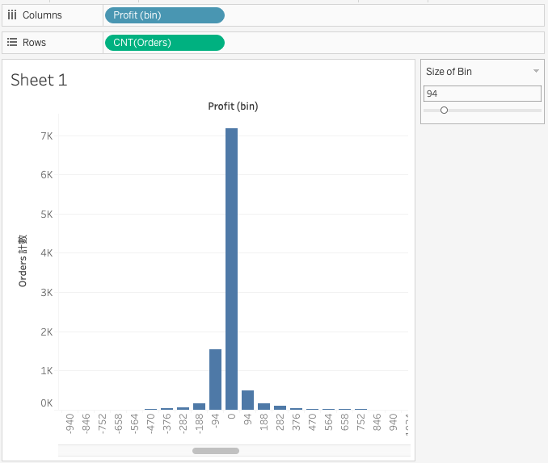
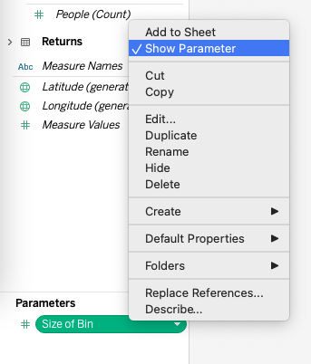
Example: Create a dynamic graph with parameter

Slide 29
Project

Slide 30
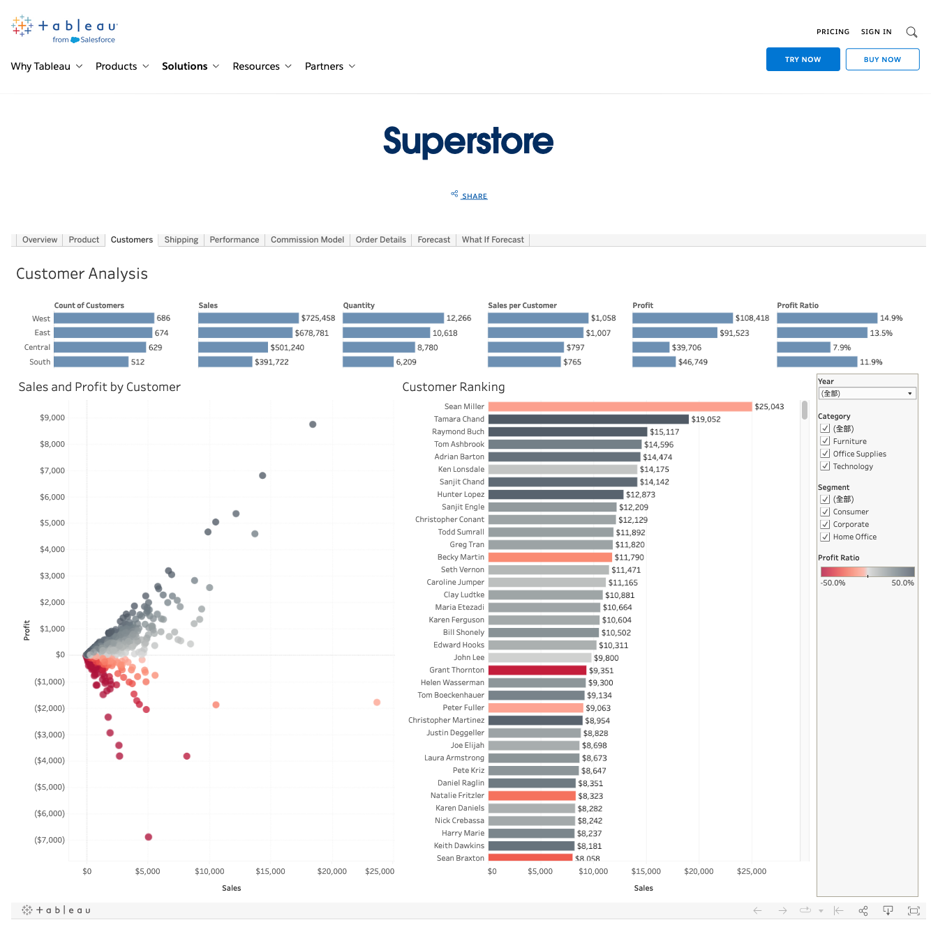
Case study
https://www.tableau.com/solutions/gallery/superstore
In this case study we will try to replicate the Customer Analysis dashboard.

Slide 31
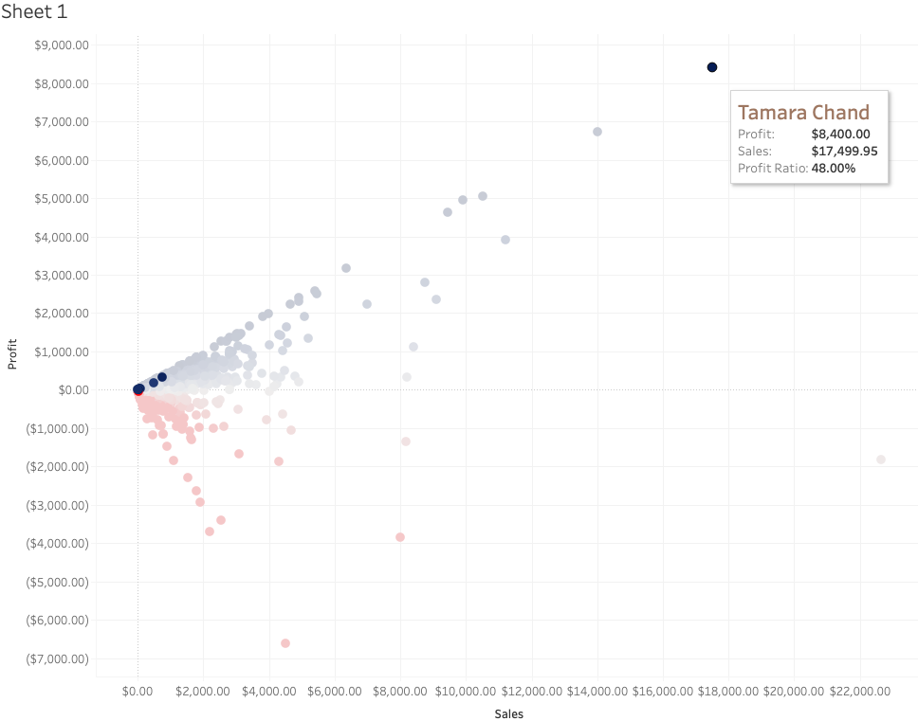
Dashboard interaction
Users can retrieve extra information by performing dashboard interaction, e.g. Hover/Click.
Example goal:
To select the points with the same customer Id.

Slide 32
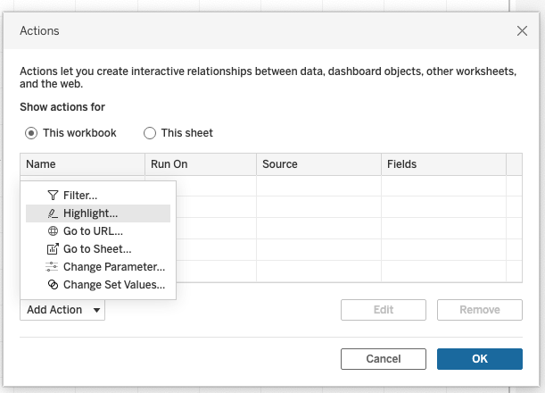
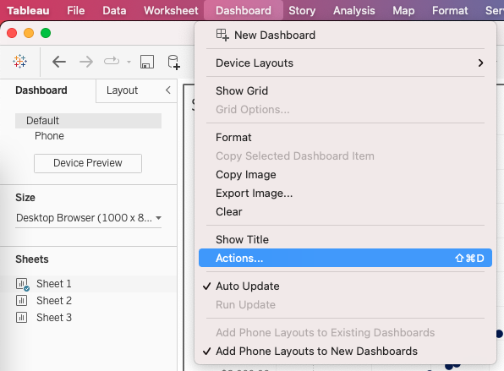
Dashboard interaction

Slide 33
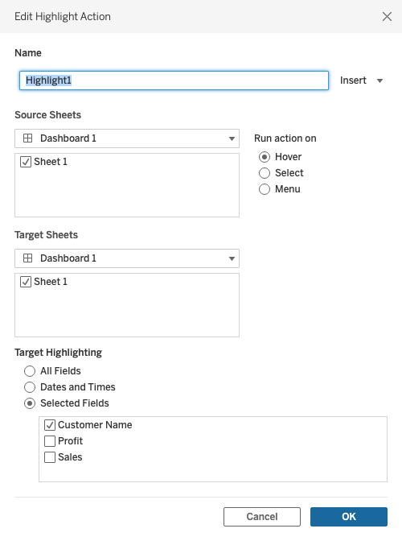
Dashboard interaction
Trigger by:
Perform action on:

